Slide 1



FINANCIAL INNOVATION LAB | BOOTCAMP TWO
OBJECTIVE
To introduce the NUDGE theory as a framework to look at the task of influencing peoples’ decisions. To introduce the concept of choice architecture.
TOOL
NUDGE THEORY

Slide 2
FINANCIAL INNOVATION LAB | BOOTCAMP TWO
ABOUT ‘STARTUP CANVAS’
The NUDGE framework is a set of principles that help design/architect the choices that people make by organising the context in which people make decisions. The framework emerges from the world of behavioural economics which proposes that rational decision making is an ideal and rare occurrence, and most people need aids to help them make the right choices.

Slide 3
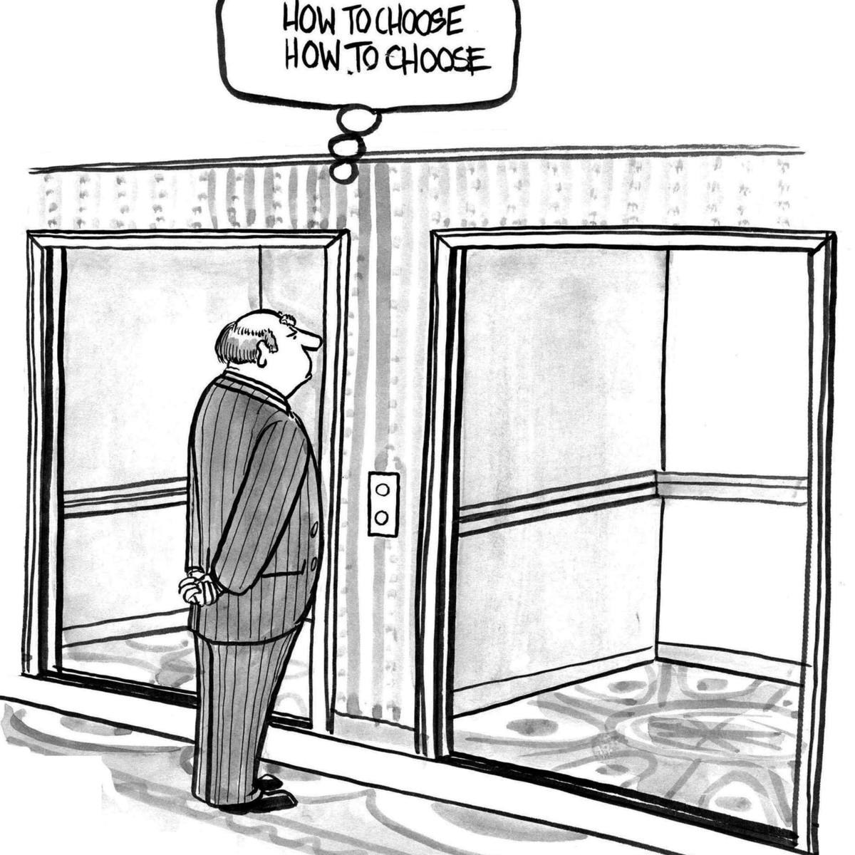
FINANCIAL INNOVATION LAB | BOOTCAMP TWO

Slide 4
FINANCIAL INNOVATION LAB | BOOTCAMP TWO
Cases when Nudges are powerful
Benefits Vs. Costs: When people have multiple choices and do not fully appreciate the true costs and benefits of their actions. They often choose short term benefit and long term cost which is not ideal.
Degree of Difficulty: When people struggle with genuinely complex choices that require a high degree of reflection, fact finding, analysis etc. so that they can make an informed choice.
Rare Choices: When people have to make decisions that are rare in nature and they are not quite able to depend on their own experiences to make a choice.
Feedback: When people can benefit from input/information about their current choices because in the absence of it self learning may be chance based or never happen.
Knowing What You Like: When people are confused about what the benefits from different choices actually mean for them, and are unable to predict how their choices will affect their life.

Slide 5
FINANCIAL INNOVATION LAB | BOOTCAMP TWO
NUDGES
Give iNcentives
What could be ‘incentives’ offered to affect the desired behaviour?
Who is the user? Who chooses? Who pays? Who profits?
These could be real rewards or costs. These could also be social rewards.

Slide 6
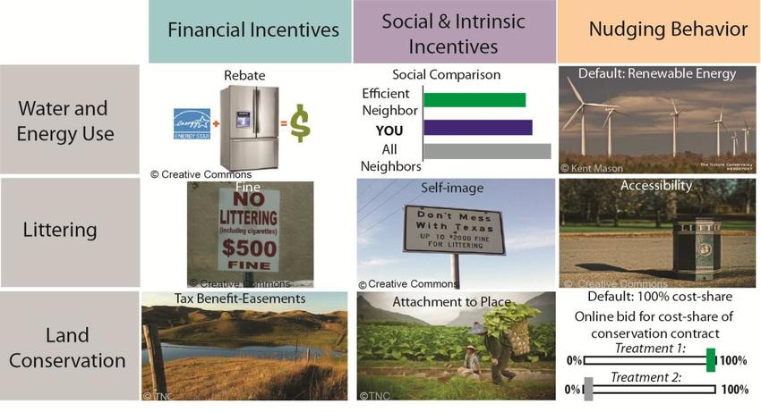
FINANCIAL INNOVATION LAB | BOOTCAMP TWO

Slide 7
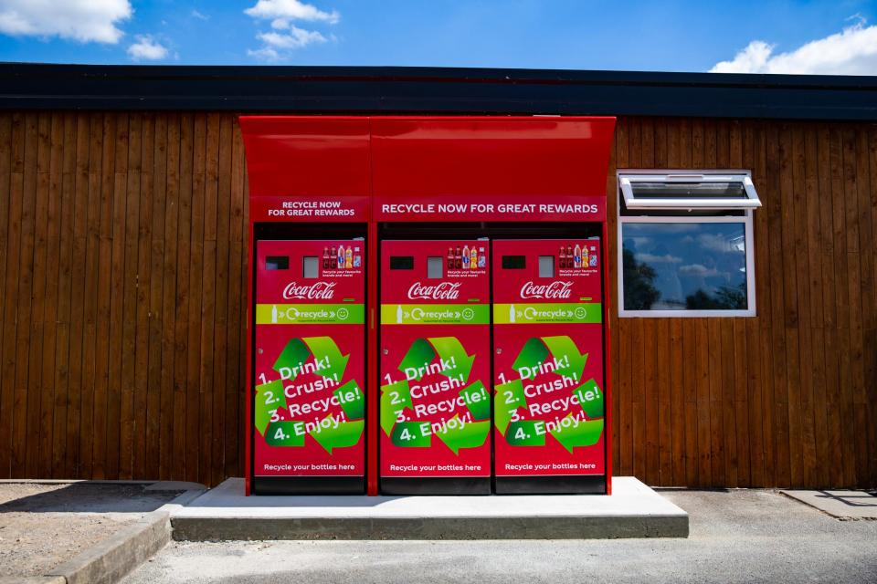
FINANCIAL INNOVATION LAB | BOOTCAMP TWO

Slide 8
FINANCIAL INNOVATION LAB | BOOTCAMP TWO
A commercial bank in the Philippines offered a savings product called SEED (Save, Earn, Enjoy Deposits) that prevented clients from accessing their funds until they reached a certain goal—either an amount or time period, decided by the client. Around one in three people offered the account opted to open one, and one in nine made regular deposits. A year after the offers went out, clients offered the accounts had increased their account balances 80 percent more than those with normal accounts.

Slide 9
FINANCIAL INNOVATION LAB | BOOTCAMP TWO
NUDGES
Understand Mappings
How do we proactively inform users so they ‘Understand’ the cost(s)-benefit(s) of choices before them?
What are the choices available? What are cost-benefits for each?
How can the choices be compared?

Slide 10
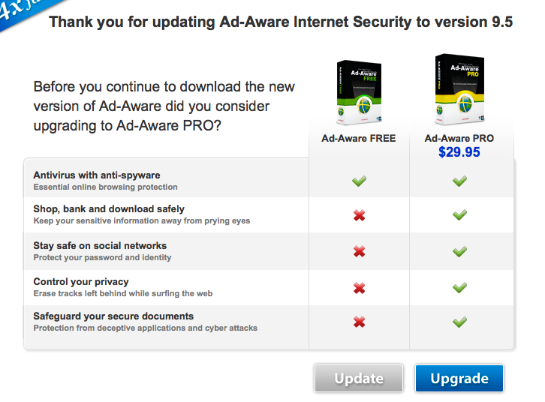
FINANCIAL INNOVATION LAB | BOOTCAMP TWO

Slide 11
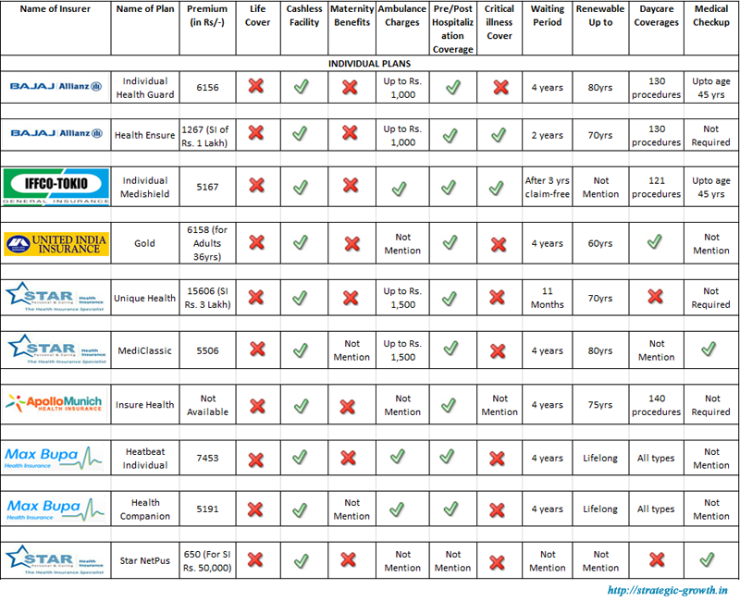
FINANCIAL INNOVATION LAB | BOOTCAMP TWO

Slide 12
FINANCIAL INNOVATION LAB | BOOTCAMP TWO
NUDGE
Set Defaults
What is the ‘default’ setting that is the closest to the desired choice we want users to make?
Which choice is recommended for greatest user benefit?
Which choice is recommended for the broader goal?
What can users opt out of and opt into?

Slide 13
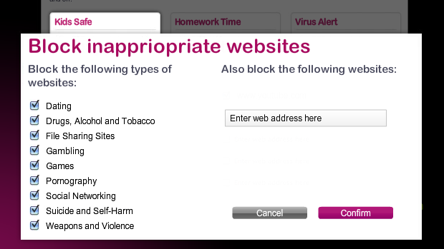
FINANCIAL INNOVATION LAB | BOOTCAMP TWO

Slide 14
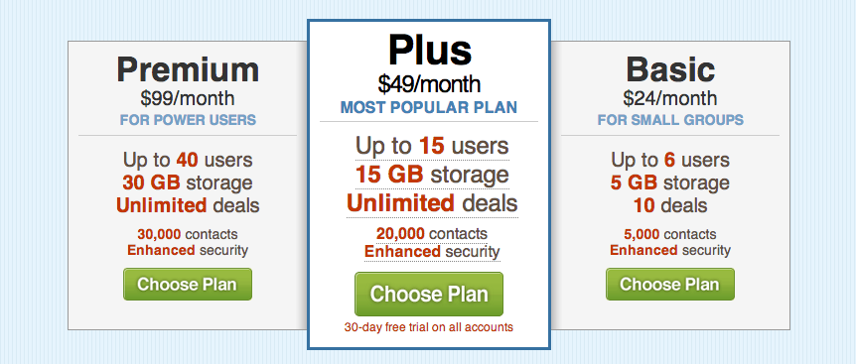
FINANCIAL INNOVATION LAB | BOOTCAMP TWO

Slide 15
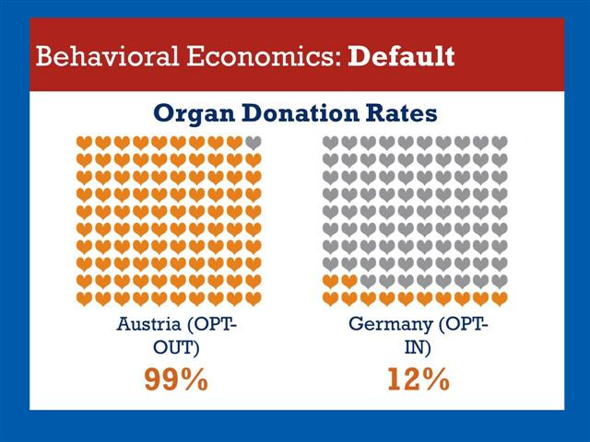
FINANCIAL INNOVATION LAB | BOOTCAMP TWO

Slide 16
FINANCIAL INNOVATION LAB | BOOTCAMP TWO
NUDGES
Give Feedback
How do we ‘give feedback’ to users when they are doing well and when they are making mistakes?
When and where do users need feedback?
How do we give negative and positive feedback?
What is the best method to give feedback?

Slide 17
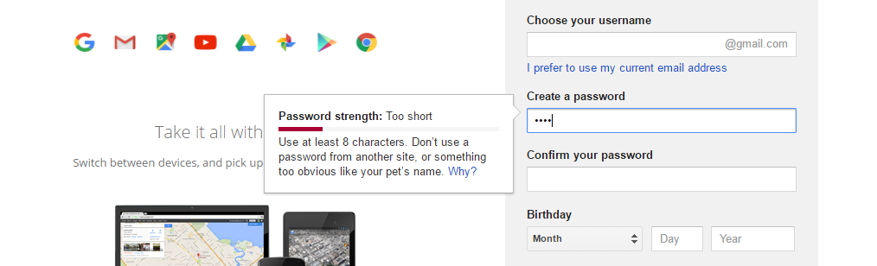
FINANCIAL INNOVATION LAB | BOOTCAMP TWO

Slide 18
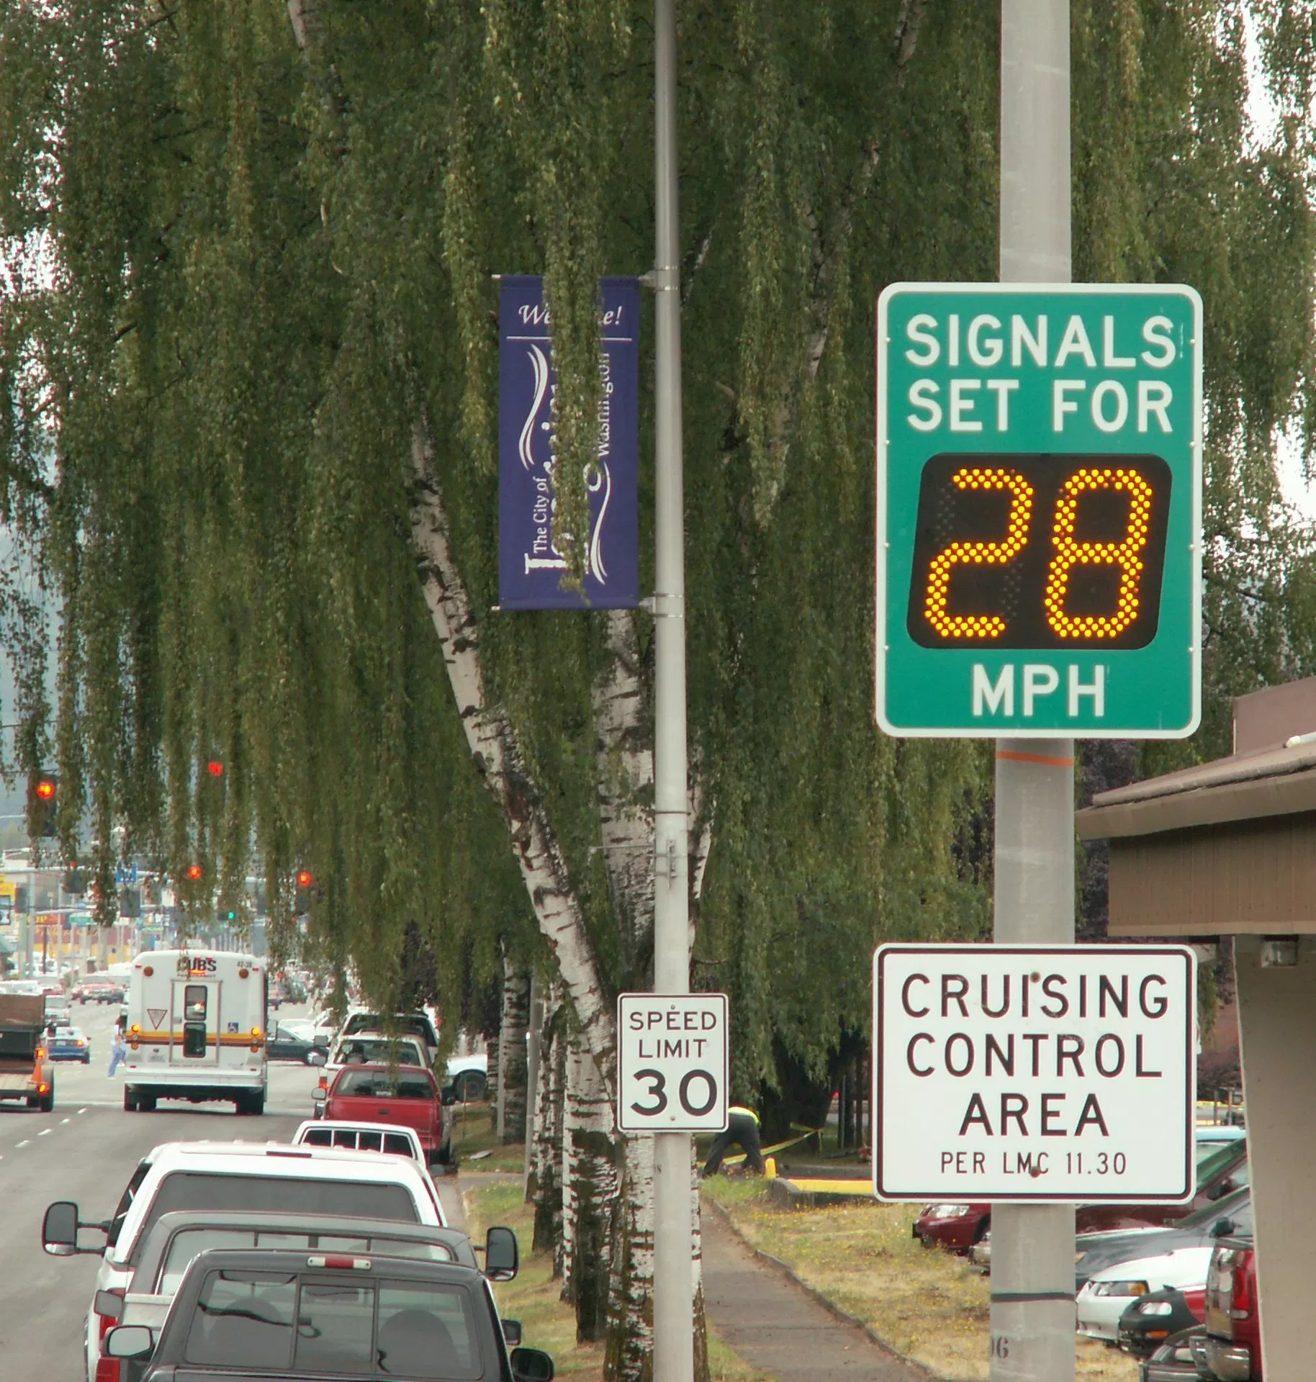
FINANCIAL INNOVATION LAB | BOOTCAMP TWO

Slide 19
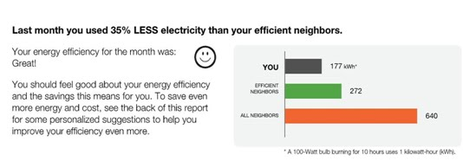
FINANCIAL INNOVATION LAB | BOOTCAMP TWO

Slide 20
FINANCIAL INNOVATION LAB | BOOTCAMP TWO
NUDGES
Expect Error
How can we accommodate and forgive ‘expected errors’ that users tend to make?
What are errors that we can expect users to make?
How do we make it work with these errors?

Slide 21
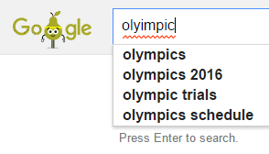
FINANCIAL INNOVATION LAB | BOOTCAMP TWO

Slide 22
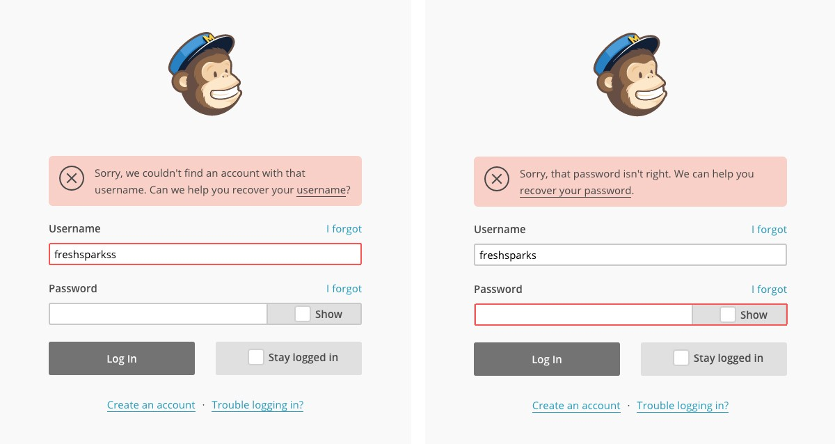
FINANCIAL INNOVATION LAB | BOOTCAMP TWO

Slide 23
FINANCIAL INNOVATION LAB | BOOTCAMP TWO
NUDGES
Structure Choices
How do we ‘structure complex choices’ in order to aid decision making?
How do we reduce the number of choices?
How do we visibly simplify?

Slide 24
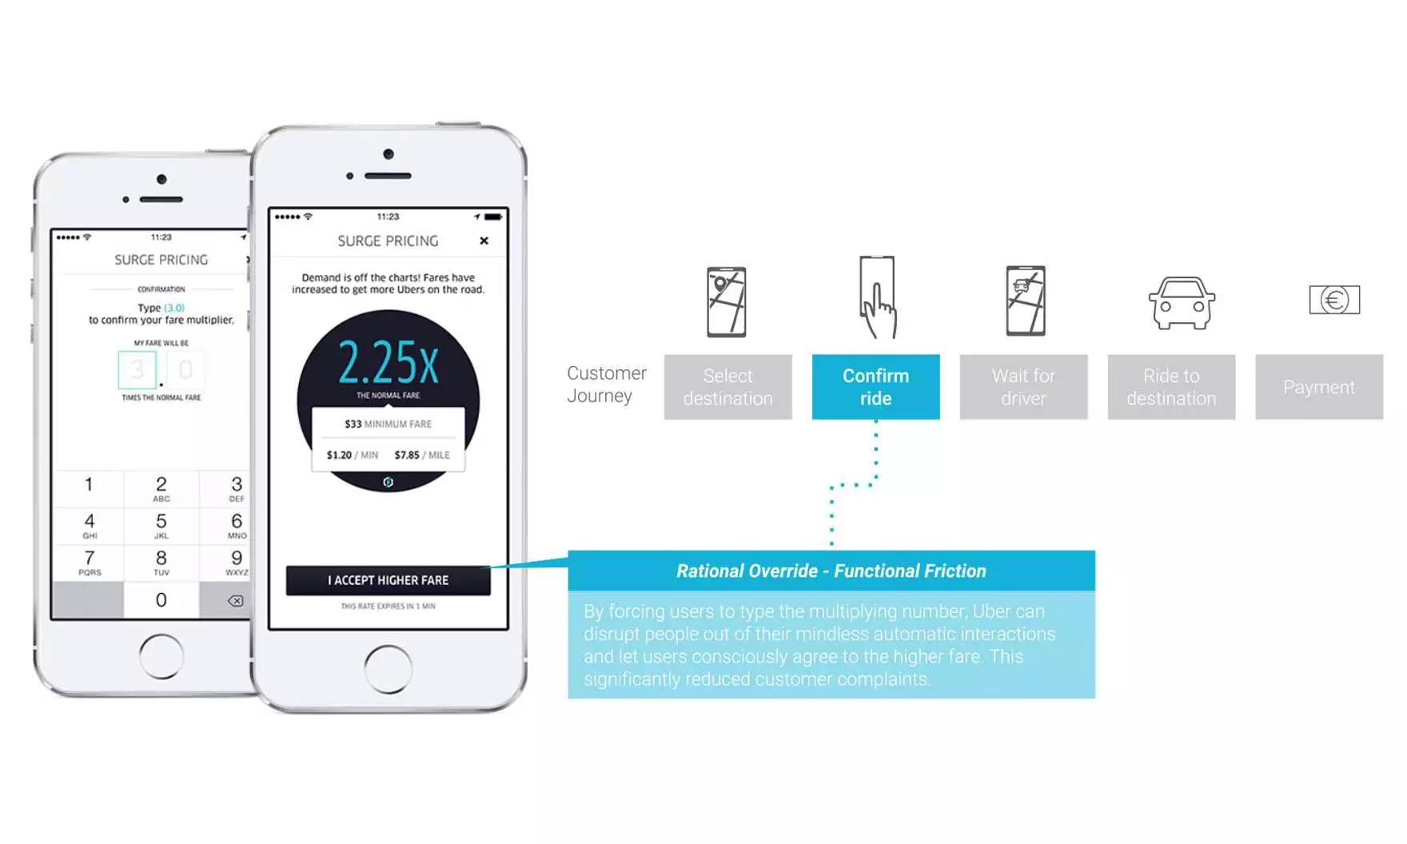
FINANCIAL INNOVATION LAB | BOOTCAMP TWO

Slide 25

FINANCIAL INNOVATION LAB | BOOTCAMP TWO

Slide 26
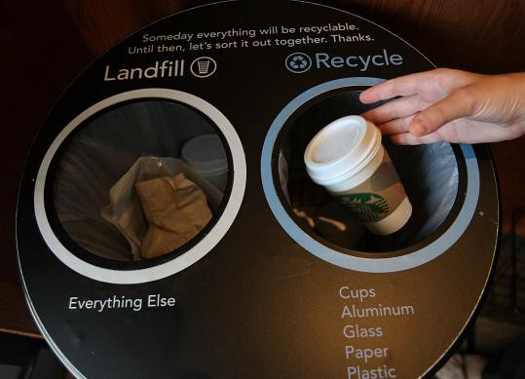
FINANCIAL INNOVATION LAB | BOOTCAMP TWO

Slide 27

FINANCIAL INNOVATION LAB | BOOTCAMP TWO

